Slide 1


Lab 3– Depth Camera
MIT Beaver Works Racecar Curriculum
https://matthewcalligaro.github.io/RacecarWebsite/

Slide 2
Lab Objectives
Main objective: Use the Intel RealSense camera to do depth sensing.
Learning objectives
Use RVIZ to explore different depth visualizations
Use the depth information from the RealSense to add a safety stop feature
Use the additional depth information to complete the cone slaloming challenge

Slide 3
Depth Sensing
What is depth sensing?
A color depth camera has pixels which have four numerical values associated with them. The first three are the RGB values, and the final corresponds to the distance/depth measurement
Depth Sensing Technologies:
Structured light, Time of Flight, Stereo triangulation

Slide 4
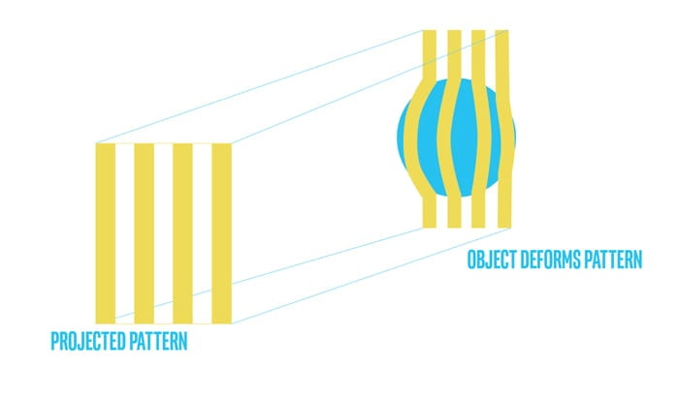
Structured Light
Illuminate scene with specific light pattern, only requires one image
Ex: Original Kinect

Slide 5
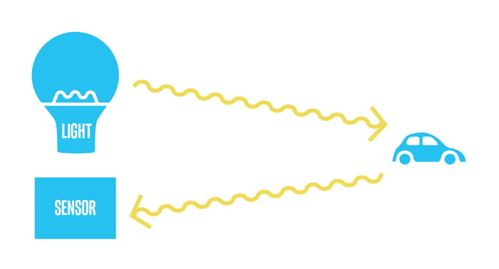
Time of Flight
Radar technology that emits a light pulse instead of RF
Ex: Kinect for Xbox One

Slide 6
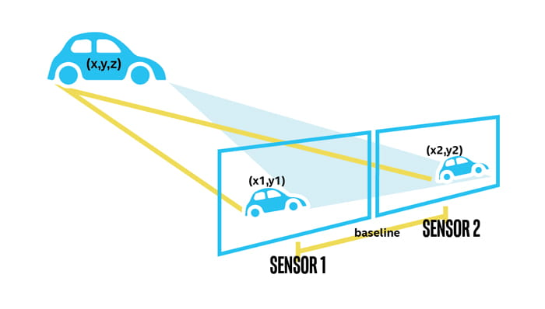
Stereo Vision
Find corresponding points on a stereo camera system
Ex: Intel RealSense

Slide 7
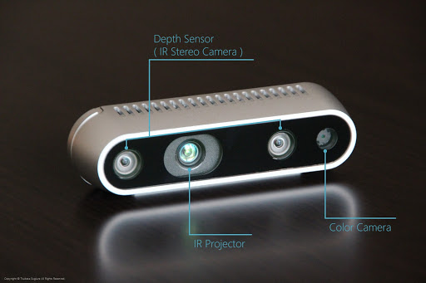
Intel RealSense – Active Stereo
Active stereo camera actively employs an IR projector to simplify the image matching issue
Helps with dark scenes, or scenes without texture

Slide 8
RVIZ

Slide 9
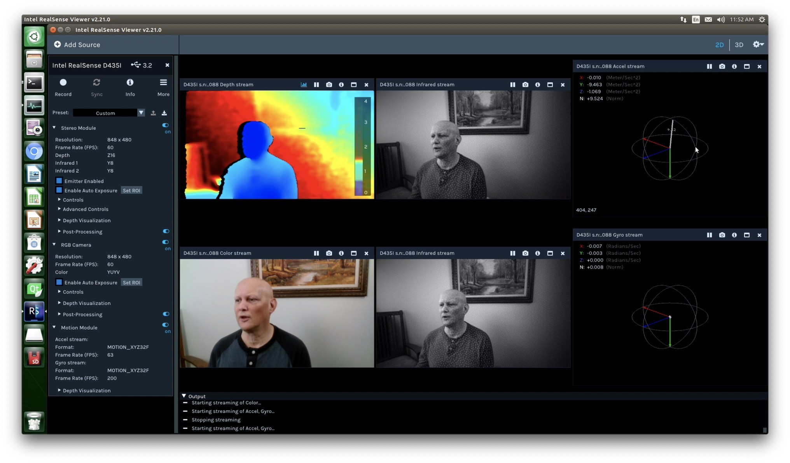
RealSense-Viewer

Slide 10
Good luck and have fun!
Let us know if you need any help during the lab

